Slide 1
Module 1.2:
Classical Supervised Models
Discriminative/ Generative Modeling
ML for Cybersecurity

Slide 2

Notes:
Suggest beginning with a motivating example of some kind, and then explaining how these two techniques (discriminative vs generative) would approach it.

Slide 3
Discriminative vs generative classification
Discriminative models
aim to estimate conditional distribution P(y | x)
Generative models
aim to estimate joint distribution P(y, x)
Can derive conditional from joint distribution, but not vice versa.
Notes:
We zoom into two typical classes of supervised classification models, namely generative models for classification.
As the name suggests, a generative model not only focuses on making classification predictions for any given data points, but also describes how data is generated, in terms of a probabilistic model.
We will discuss a few concrete generative classification models, starting from ones that make strong distributional assumptions of the data, namely the Naive Bayes model, and then look into techniques that lift those assumptions for more general generative classification tasks.
We would like to statistically model the data:
Quantify uncertainty
Express prior knowledge / assumptions about the data

Slide 4
Discriminative models

Slide 5

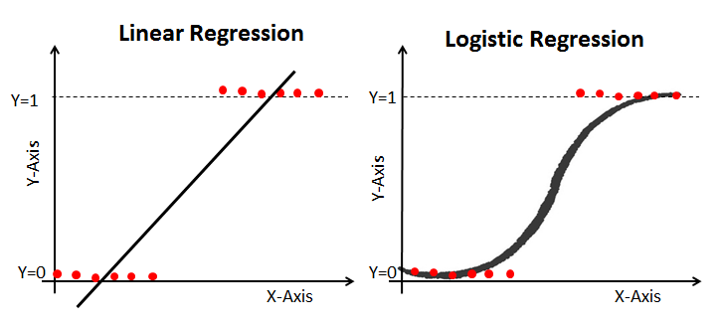
Logistic Regression
Use regression model for class probability

Slide 6
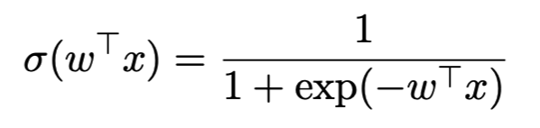
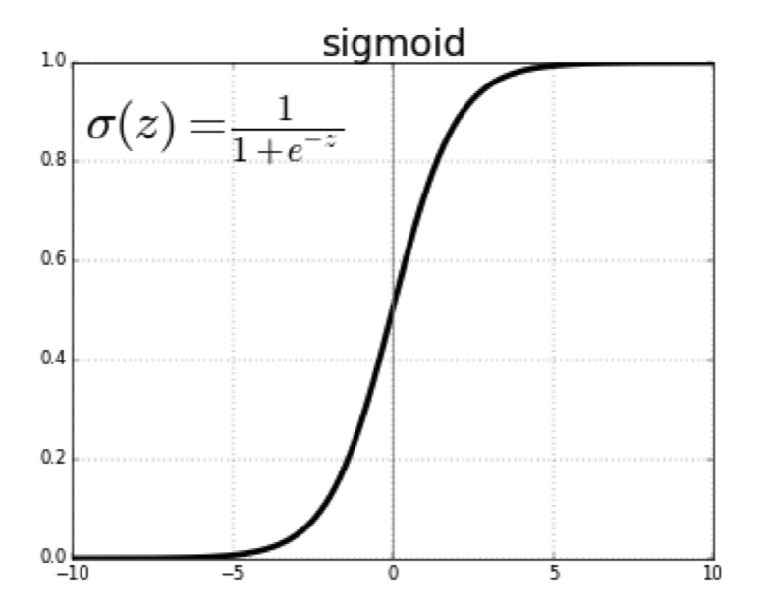
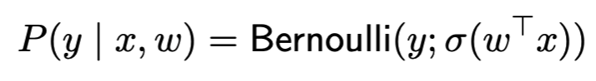
Parameter Estimation for Logistic Regression
Logistic regression assumes Bernoulli noise via a link function
Parameter could be estimated by
Maximum likelihood estimation (MLE)
Maximum a posteriori estimation (MAP)

Slide 7
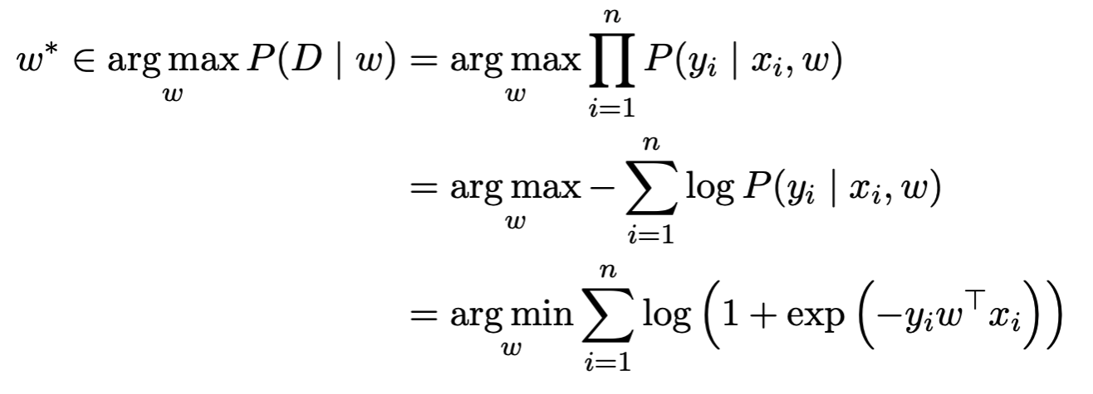
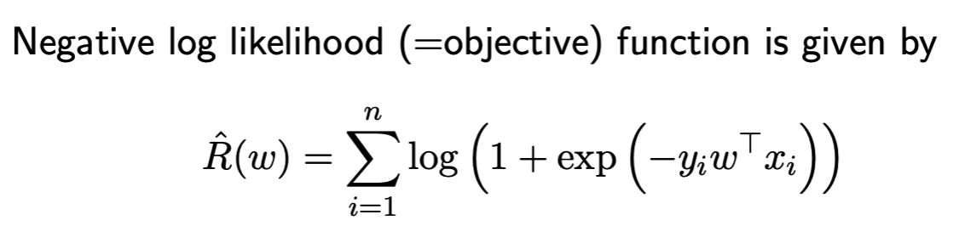
MLE for Logistic Regression
w could be efficiently optimized with (stochastic) gradient descent!

Slide 8
Demo: Logistic Regression
Notes:
Application – replace with cybersecurity application (spam filtering)
Incorporating the notebook demo
- Why they should care about SGD

Slide 9
Demo: Regularized Logistic Regression
Notes:
Application – replace with cybersecurity application (spam filtering)
Incorporating the notebook demo
- Why they should care about SGD

Slide 10
Generative Models

Slide 11
Failure Cases for Logistic Regression
What will logistic regression predict for data point x?
Notes:
Add forward pointer to evasion attacks

Slide 12
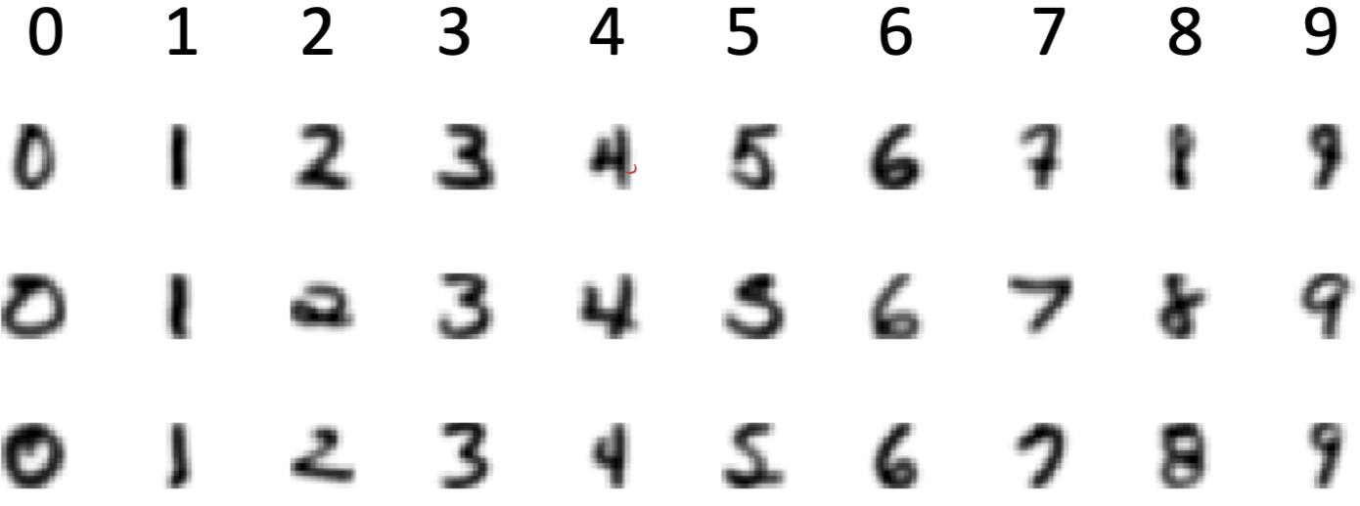
Typical Approaches to Generative Modeling
Estimate prior on labels P(y)
Estimate conditional distribution P(x | y) for each class y
Obtain predictive distribution using Bayes’ rule: P(y | x) = P(y) P(x | y) / Z
Example: hand-written digits

Slide 13
Naïve Bayes Classifier (NB)
Simple generative model
P(y)
P(x | y)
Credit @NOELIAGOROD

Slide 14
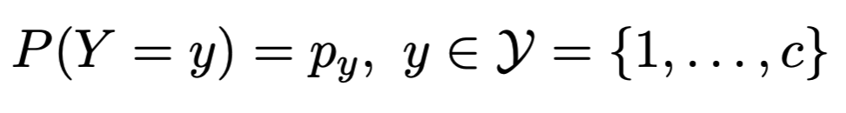
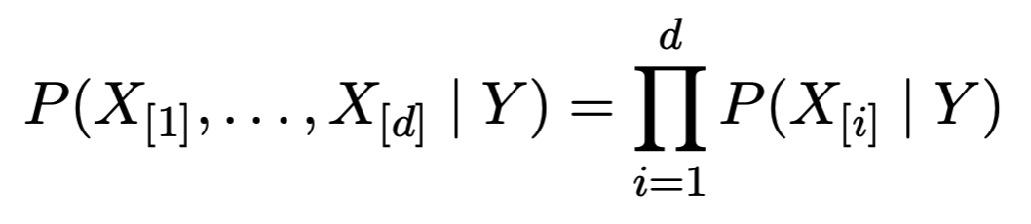
Naïve Bayes Classifier (NB)
Model class label as generated from categorical variable
Model features as conditionally independent given label
given class label, each feature is generated independently of the other features
need to specify feature distribution P(X_{[i]} | Y )

Slide 15
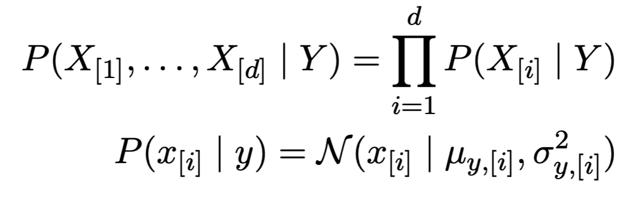
Gaussian Naïve Bayes Classifier
Model class label as generated from categorical variable
Model features as conditionally independent Gaussians
given class label, each feature is generated independently of the other features
need to specify feature distribution P(X_{[i]} | Y)

Slide 16
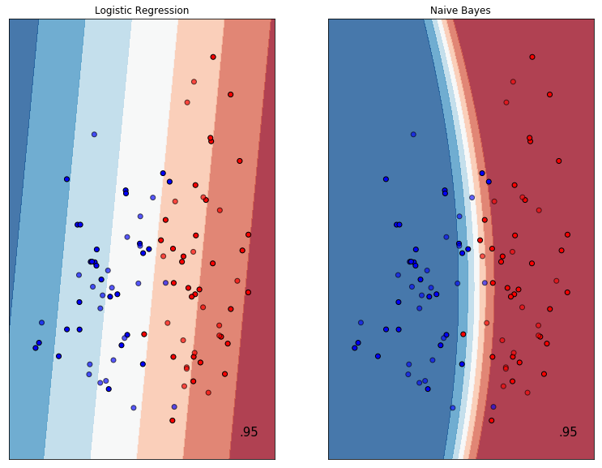
Demo: Demo: Gaussian NB vs LR (linear)

Slide 17
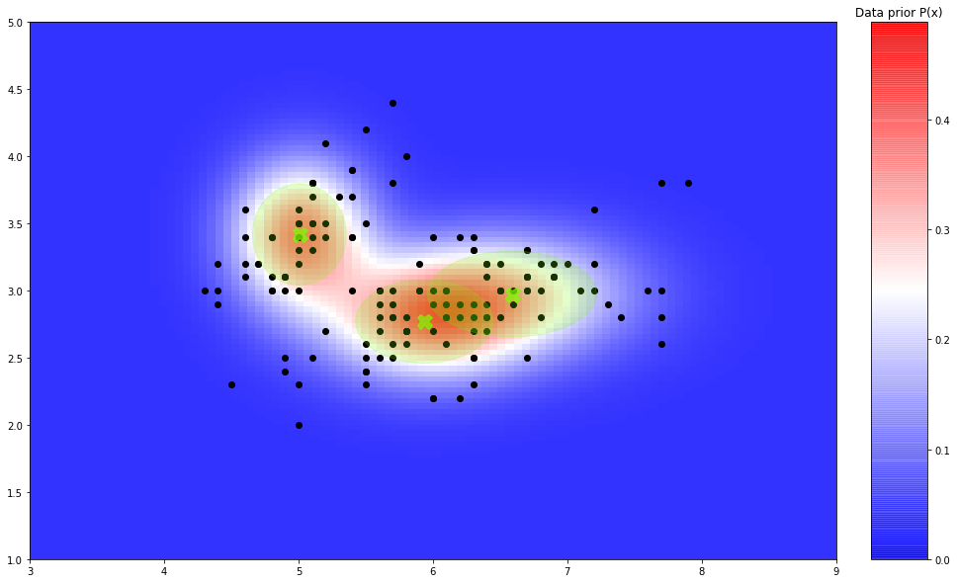
Demo: Gaussian NB for Anomaly Detection
Notes:
Adding a slide on
- Rules of thumb when each model should be used

Slide 18
Concluding remarks
Discriminative models
model P(y | x). Do not attempt to model P(x)
cannot detect outliers (property of P(x))
are typically more robust, since accurately modeling x may be difficult
Generative models
model joint distribution P(x, y)
can be more powerful (e.g. detect outliers) if model assumptions are met
are typically less robust against outliers
Notes:
Are there any rules of thumb or guidelines you would provide around the strengths and weaknesses of discriminative vs generative approaches, or when, as a practitioner, your instinct should be to use one vs the other?

